Slide 1
E-retail factors for customer activation and retention: A case study from Indian e-commerce customers
Customer satisfaction has emerged as one of the most important factors that guarantee the success of online store; it has been posited as a key stimulant of purchase, repurchase intentions and customer loyalty. A comprehensive review of the literature, theories and models have been carried out to propose the models for customer activation and customer retention. Five major factors that contributed to the success of an e-commerce store have been identified as: service quality, system quality, information quality, trust and net benefit. The research furthermore investigated the factors that influence the online customers repeat purchase intention. The combination of both utilitarian value and hedonistic values are needed to affect the repeat purchase intention (loyalty) positively. The data is collected from the Indian online shoppers. Results indicate the e-retail success factors, which are very much critical for customer satisfaction.

Slide 2
Checking Null Values
No Null Values Present in the Dataset
Checking the shape of Dataset
Dataset contains 269 rows and 71 columns

Slide 3
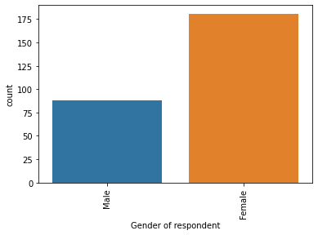
EDA
Female has taken the survey more than male

Slide 4
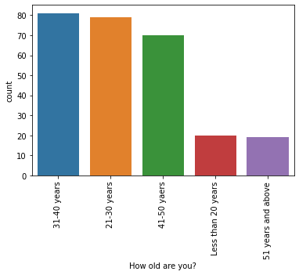
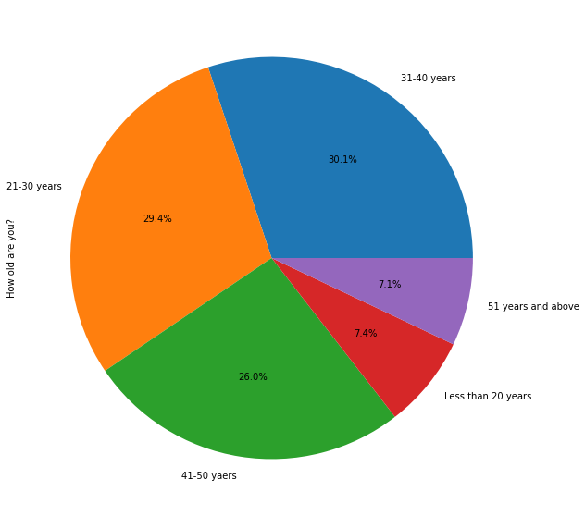
31-40 years old use online store most
33% of person are aged between 31-40yrs
29% of person are aged between 21-30yrs
26% of person are aged between 41-50yrs

Slide 5
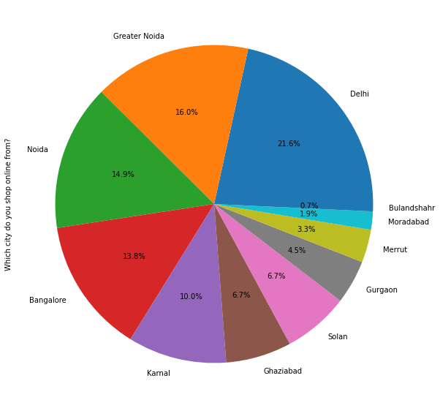
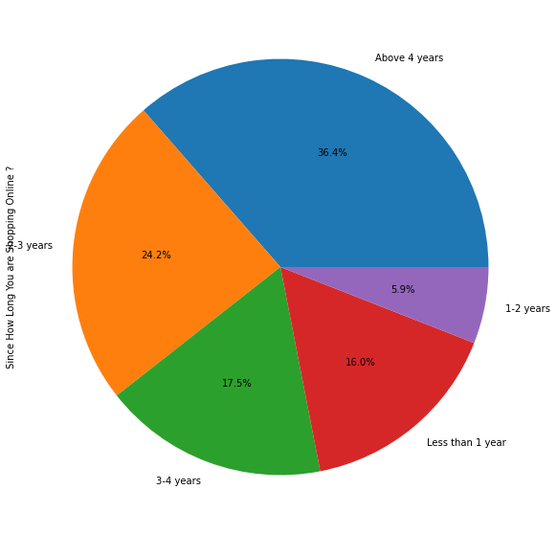
People staying at Delhi and Noida opts for online shopping more
Most of the People using online shopping for more than 2.5 years

Slide 6
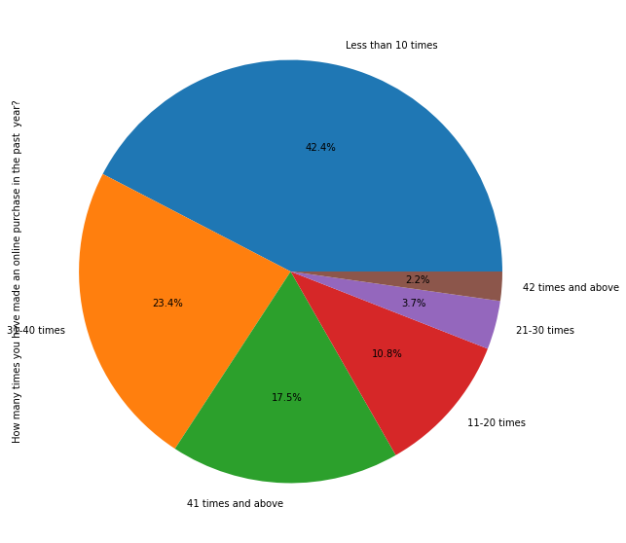
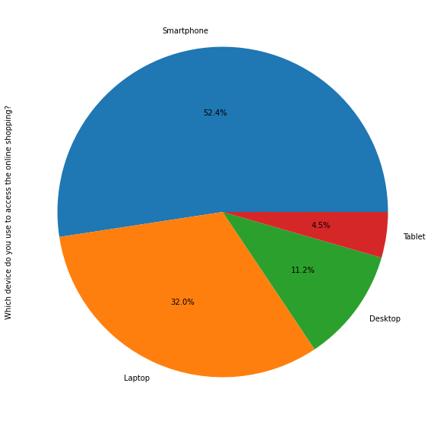
52% of users are using mobile data to use online shopping platforms followed by 28.3% using Wifi.
Half of the persons are using there smartphone to access online shopping site

Slide 7
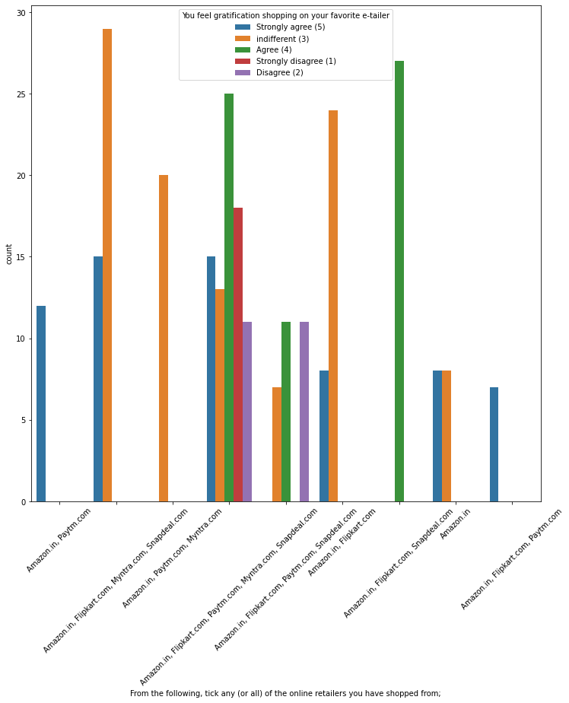
Almost all the people who have shopped from Amazon, Flipkart and Paytm are satisfied. People who shop from a more number of online brands dose’nt seem to be satisfied.

Slide 8
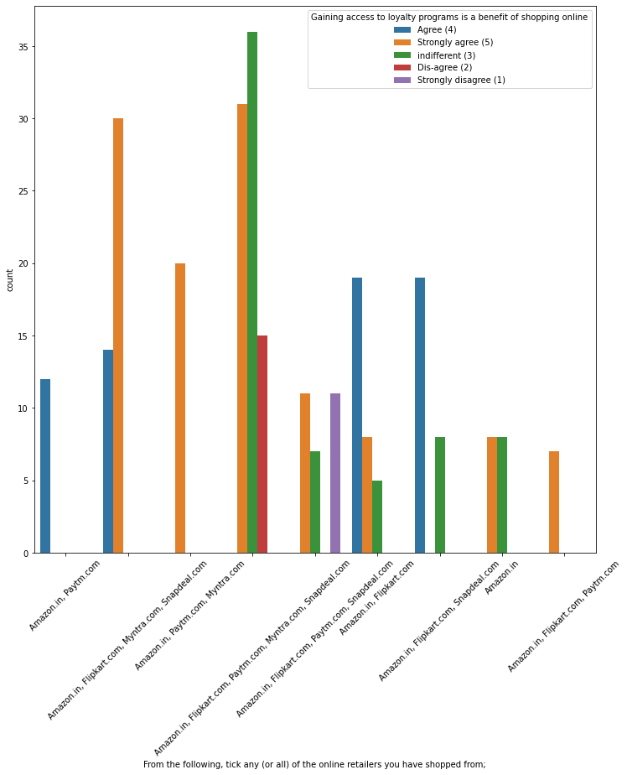
People shopping from Amazon and Paytm are getting benefits from the loyalty points, Flipkart and Snapdeal also seem to give such benefits but people who shop from almost everywhere disagree with this statement too

Slide 9
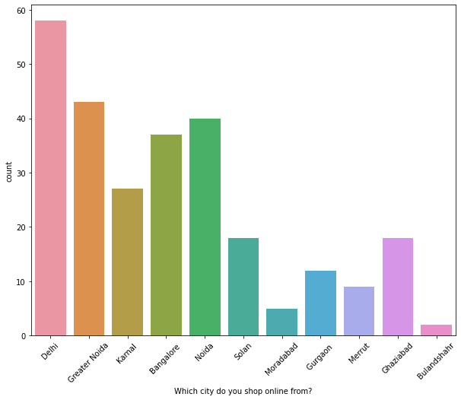
Person living in Delhi and Noida do more online shopping and person living in Bulandshahr is using online shopping leas

Slide 10
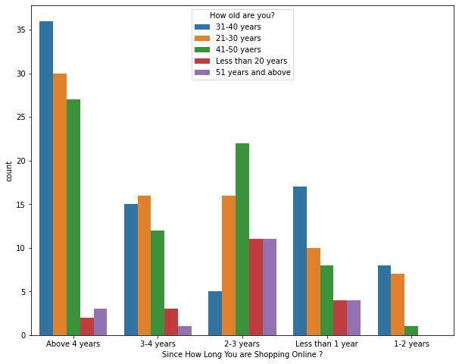
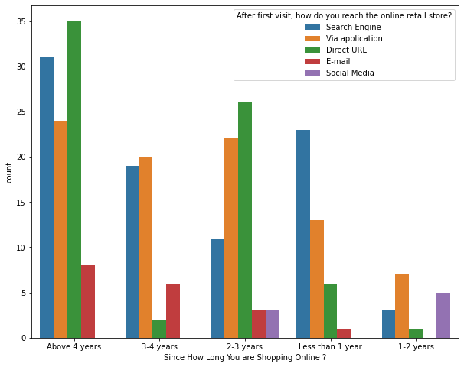
Highest number of people have been shopping online for above 4 years except for the age group below 20 years and above 50 years. People who are shopping online for 1-2 years does not include teenagers and elder people
People who are shopping online for more than 3 years do not use the application rather use search engine and direct url's in large number which indicates that online brands should update all their platforms rather than just application

Slide 11
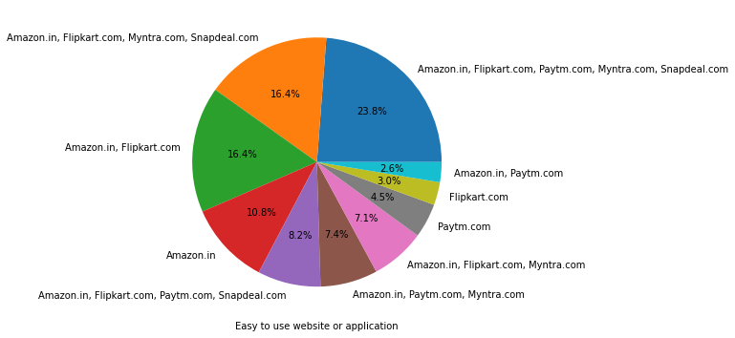
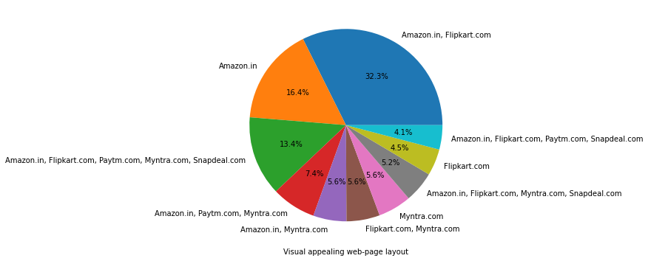
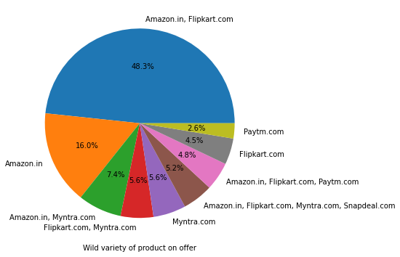
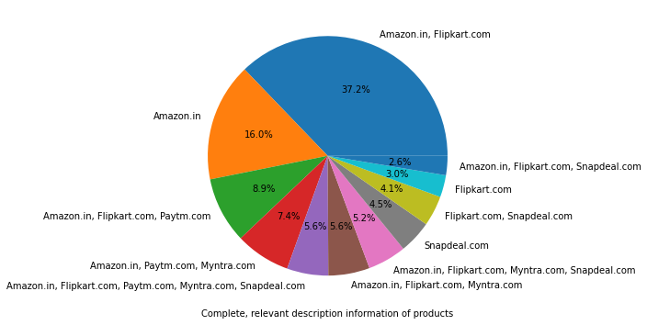

Slide 12
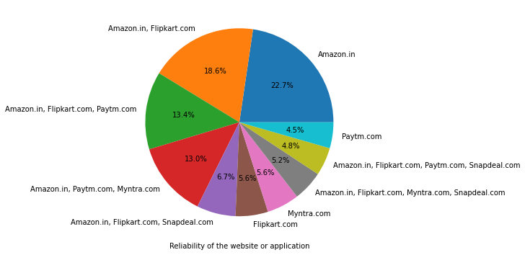
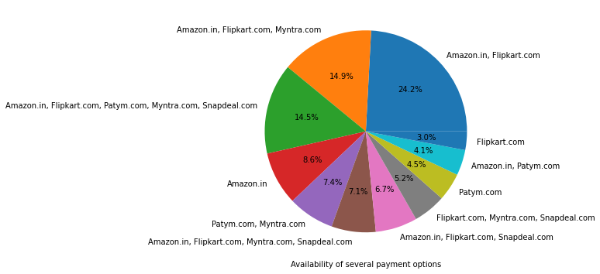
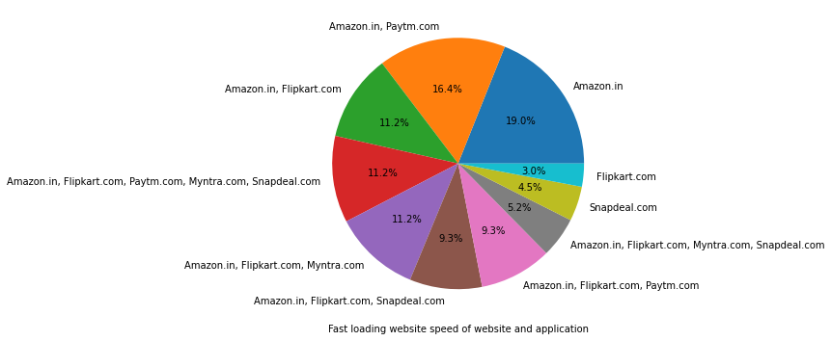
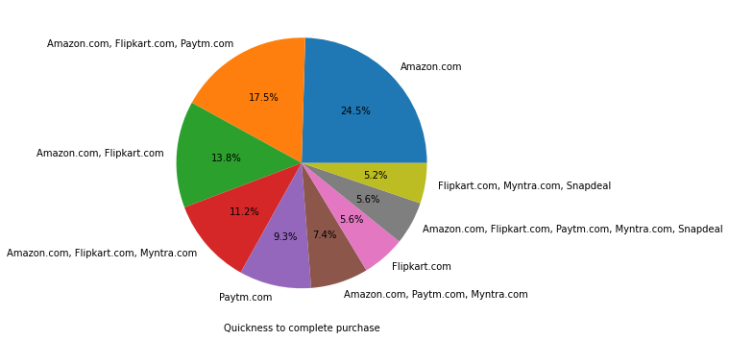
Amazon, Flipkart have been had the highest votes for having all the positive points and have maintained a very good brand image followed by Paytm and the Myntra.

Slide 13
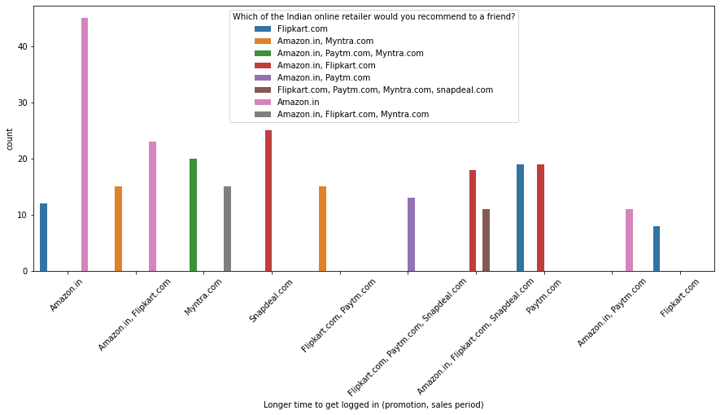

Slide 14
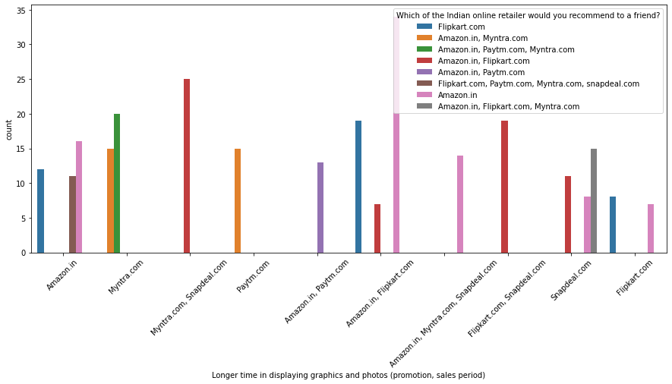

Slide 15
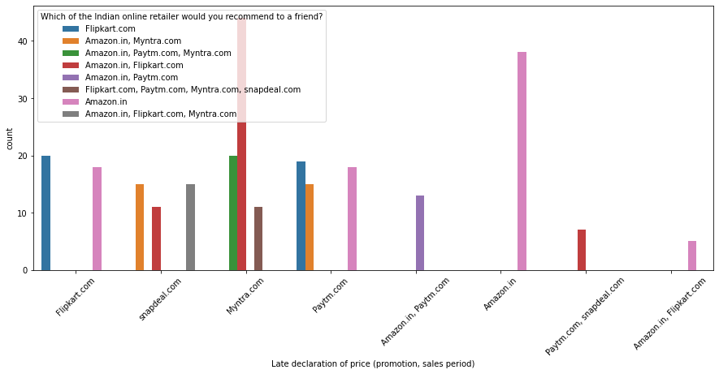

Slide 16
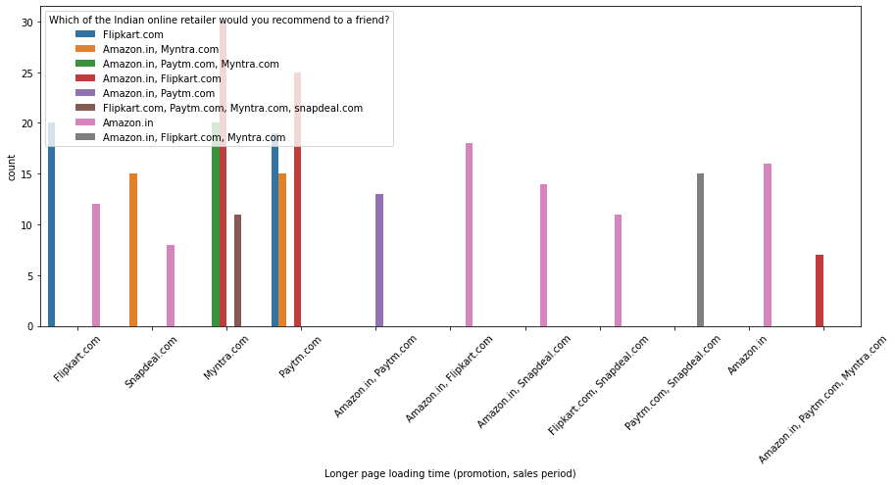

Slide 17
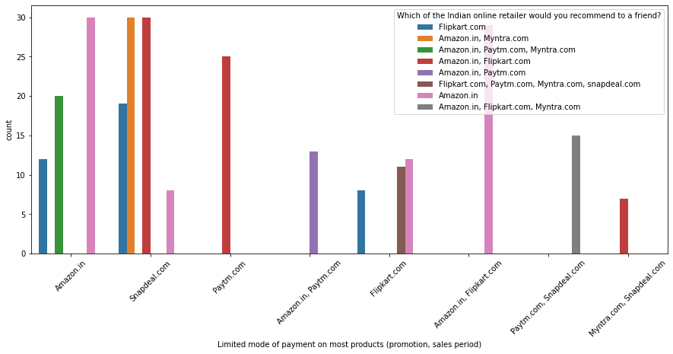

Slide 18
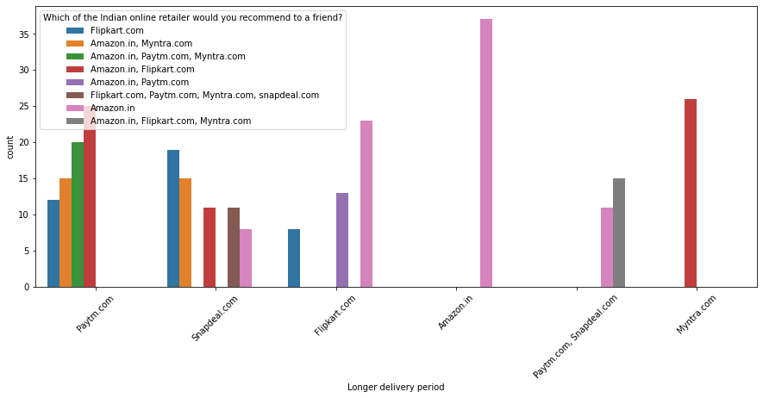

Slide 19
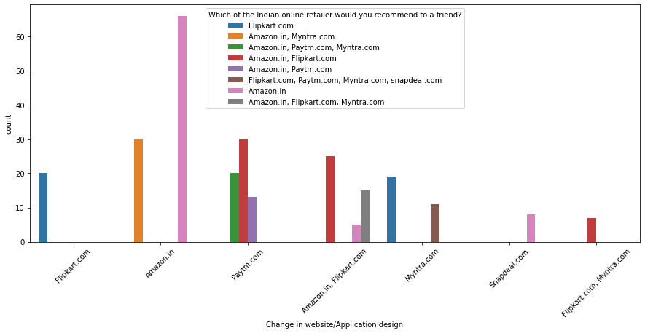

Slide 20
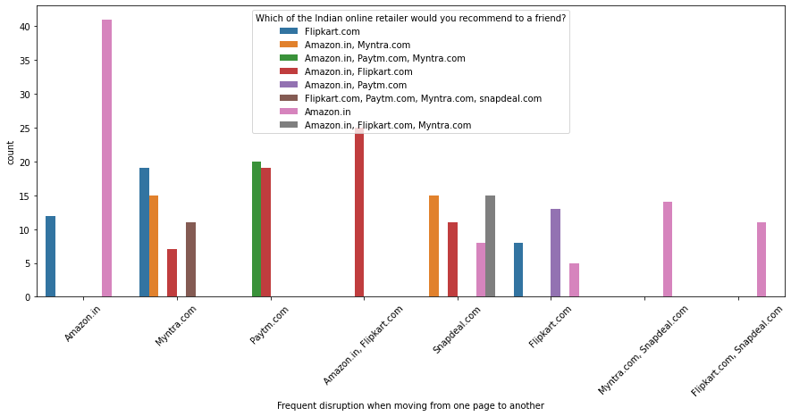

Slide 21
Customers seem to be more loyal to amazon, flipkart and paytm as even though many of them have given negative remarks about them still they would recommend these platforms to their friend

